Slide 1
Software Transactional Memory
Kevin Boos

Slide 2
Two Papers
Software Transactional Memory for Dynamic-Sized Data Structures (DSTM) – Maurice Herlihy et al – Brown University & Sun Microsystems – 2003
Understanding Tradeoffs in Software Transactional Memory – Dave Dice and Nir Shavit – Sun Microsystems – 2007

Slide 3
Outline
Dynamic Software Transactional Memory (DSTM)
Fundamental concepts
Java implementation + examples
Contention management
Performance evaluation
Understanding Tradeoffs in STM
Prior STM Work
Transaction Locking
Analysis and Observations

Slide 4

Software Transactional Memory
Fundamental Concepts

Slide 5
Overview of STM
Synchronize shared data without locks
Why are locks bad?
Poor scalability, challenging, vulnerable
Transaction – a sequence of steps executed by a thread
Occurs atomically: commit or abort
Is linearizable: appears one-at-a-time
Slower than HTM
But more flexible
Notes:
Coarse-grained locks do not scale.
-- Threads block each other when they wouldn’t actually interfere
-- lock is a source of contention
Fine-grained locks are better for scalability
-- difficult to implement
-- hard to guarantee correctness and avoid deadlock
Locks cause vulnerability to thread failures. A thread preempted while holding a lock will delay other threads waiting on that lock.

Slide 6
Dynamic STM
Prior STM designs were static
Transactions and memory usage must be pre-declared
DSTM allows dynamic creation of transactions
Transactions are self-aware and introspective
Creation of transactional objects is not a transaction
Perfect for dynamic data structures: trees, lists, sets
Deferred Update over Direct Update
Notes:
A transaction can decide on execution order of future operations based on values from previous operations in the same transaction.

Slide 7
Obstruction Freedom
Non-blocking progress condition
Stalling of one thread cannot inhibit others
Any thread running by itself eventually makes progress
Guarantees freedom from deadlock, not livelock
“Contention Managers” must ensure this
Allows for notion of priority
High-priority thread can either wait for a low-priority thread to finish, or simply abort it
Not possible with locks
Notes:
Livelock is like a stalemate.
Two people are in a narrow hallway, one tries to go right, the other tries to go the same direction. This keeps progressing.
They’re making progress from the perspective of one of them, but as a whole they’re not getting anywhere.

Slide 8
Progress Conditions
Some process makes progress, guaranteed if running in isolation
Some process makes progress in a finite number of steps
wait
free
Lock-free
Obstruction-free
Every process makes progress in a finite number of steps

Slide 9
Implementation in Java

Slide 10
Transactional Objects
Transactional object: container for Java Object Counter c = new Counter(0); TMObject tm = new TMObject(c);
Classes that are wrapped in a TMObject must implement the TMCloneable interface
Logically-disjoint clone is needed for new transactions
Similar to copy-on-write

Slide 11
Using Transactions
TMThread is basic unit of parallel computation
Extends Java Thread, has standard run() method
For transactions: start, commit, abort, get status
Start a transaction with begin_transaction()
Transaction status is now Active
Transactions have read/write access to objects Counter counter = (Counter)tm0bject.open(WRITE); counter.inc(); // increment the counter
open() returns a cloned copy of counter

Slide 12
Committing Transactions
Commit will cause the transaction to “take effect”
Incremented value of counter will be fully written
But wait! Transactions can be inconsistent …
Transaction A is active, has modified object X and is about to modify object Y
Transaction B modifies both X and Y
Transaction A sees the “partial effect” of Transaction B
Old value of X, new value of Y

Slide 13
Validating Transactions
Avoid inconsistency: validate the transaction
When a transaction attempts to open() a TMObject, check if other active transactions have already opened it
If so, open() throws a DENIED exception
Avoids wasted work, the transaction can try again later
Could solve this with nested transactions…

Slide 14
Managing Transactional Objects

Slide 15
TMObject Details
Transactional Object (TMObject) has three fields
newObject
oldObject
transaction – reference to the last transaction to open the TMObject in WRITE mode
Transaction status – Active, Committed, or Aborted
All three fields must be updated atomically
Used for opening a transactional object without modifying the current version (along with clone())
Most architectures do not provide such a function

Slide 16
Locators
Solution: add a level of indirection
Can atomically “swing” the start reference to a different Locator object with CAS

Slide 17
Open Committed TMObject

Slide 18
Open Aborted TMObject

Slide 19
Multi-Object Atomicity
transaction
ACTIVE
COMMITTED
status
ABORTED
transaction
transaction
transaction
new object
new object
new object
old object
old object
old object
Data
Data
Data
Data
Data
Data
Notes:
Diagram of three locators, with each locator’s transaction field pointing to a single shared transaction’s status

Slide 20
Open TMObject Read-Only
Does not create new Locator object, no cloning
Each thread keeps a read-only table
Key: (object, version) – (o, v)
Value: reference count
open(READ) increments reference count
release() decrements reference count

Slide 21
Commit TMObject
First, validate the transaction
For each (o, v) pair in the thread’s read-only table, check that v is still the most recently committed version of o
Check that the Transaction’s status is Active
Then call CAS to change Transaction status
Active → Committed

Slide 22
Conflict Reduction

Slide 23
Search in READ Mode
Useful for concurrent access to large data structures
Trees – walking nodes always starts from root
Multiple readers is okay, reduces contention
Fewer DENIED transactions, less wasted effort
Found the proper node?
Upgrade to WRITE mode for atomic access
Notes:
And if you’re deleting a node in a linked data structure, you only need to hold write access to those nodes which reference the node you’re deleting.
In this way, transactions are much better than a coarse-grained lock.

Slide 24
Pre-commit release()
Transaction A can release an Object X opened for reading before committing the entire transaction
Other transactions will no longer conflict with X
Also useful for traversing shared data structures
Allows transactions to observe inconsistent state
Validations of that transaction will ignore Object X
The inconsistent transaction can actually commit!
Programmer is responsible – use with care!

Slide 25
Contention Management

Slide 26
Basic Principles
Obstruction freedom does not ensure progress
Must explicitly avoid livelock, starvation, etc.
Separation between correctness and progress
Mechanisms are cleanly modular

Slide 27
Contention Manager (CM)
Each thread has a Contention Manager
Consulted on whether to abort another transaction
Consult each other to compare priorities, etc.
Correctness requirement is weak
Any active transaction is eventually permitted to abort other conflicting transactions
Required for obstruction freedom
If a transaction is continually denied abort permissions, it will never commit even if it runs “by itself” (deadlock)
If transactions conflict, progress is not guaranteed
Notes:
Runs “by itself” means that no other concurrent transaction takes a step, not that there are no other concurrent transactions in existence.

Slide 28
ContentionManager Interface
Should a Contention Manager guarantee progress?
That is a question of policy, delegate it …
DSTM requires implementation of CM interface
Notification methods
Deliver relevant events/information to CM
Feedback methods
Polls CM to determine decision points
CM implementation is open research problem
Notes:
Notification Methods
-- commitTransactionSucceeded
-- commitTransactionFailed
-- openReadAttempted
-- openWriteAttempted
Feedback Methods
-- shouldAbort

Slide 29
CM Examples
Aggressive
Always grants permission to abort conflicting transactions immediately
Polite
Backs off from conflict adaptively
Increasingly delays aborting a conflicting transaction
Sleeps twice as long at each attempt until some threshold
No silver bullet – CMs are application-specific

Slide 30
Results

Slide 31
DSTM with many threads
Notes:
Difference between aggressive and polite Contention Managers
Simple locking is good for a single thread, but quickly drops off.
RB tree has great performance when aggressive, but bad performance when polite
In contrast, IntSet has bad performance when aggressive, but better performance when polite.
Adding “release” capabilities in can also improve performance substantially.
80/20 rule

Slide 32
DSTM with 1 thread per processor

Slide 33
Overview of DSTM

Slide 34
DSTM Recap
DSTM allows simple concurrent programming with complex shared data structures
Pre-detect and decide on aborting upcoming transactions
Release objects before committing transaction
Obstruction freedom: weaker, non-blocking progress
Define policy with modular Contention Managers
Avoid livelock for correctness

Slide 35
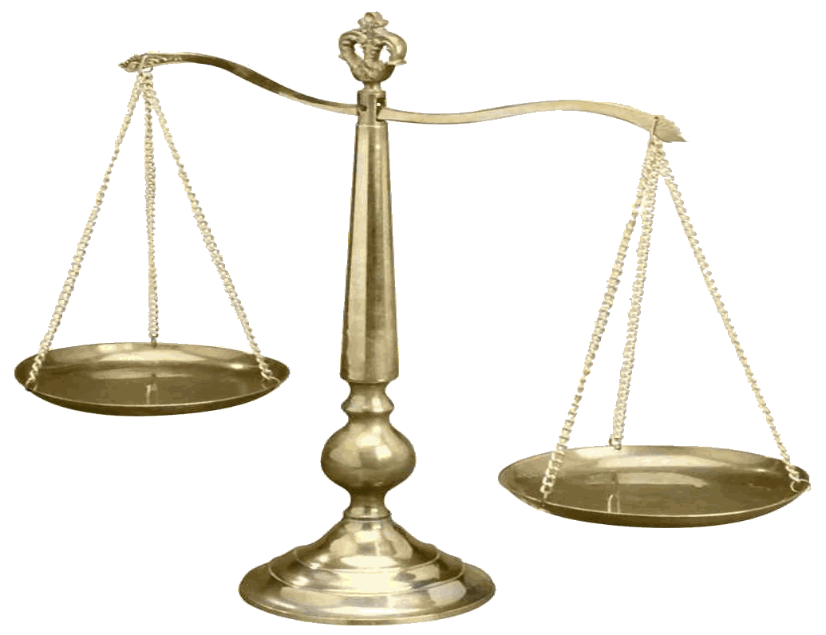
Tradeoffs in STM

Slide 36
Outline
Prior STM Approaches
Transactional Locking Algorithm
Non-blocking vs. Blocking (locks)
Analysis of Performance Factors

Slide 37
Prior STM Work
Shavit & Touitou – First STM
Non-blocking, static
Herlihy – Dynamic STM
Indirection is costly
Fraser & Harris – Object STM
Manually open/close objects
Faster, less indirection
Marathe – Adaptive STM
_{obstruction-free lock-free}
_{DSTM}
_{ASTM}
per-transaction per-object
indirect direct indirect
_{OSTM}
eager lazy eager
Notes:
Eager acquire – aquire TMObjects at open time (early conflict detection)
Lazy acquire – acquire TMObjects at commit time
-- reduces window of contention
-- extra bookkeeping and validation costs
White areas have nothing in particular to recommend them
Grey areas seem like distinctly bad ideas
ASTM adapts across entire quadrant

Slide 38
Blocking STMs with Locks
Ennals – STM Should Not Be Obstruction-Free
Only useful for deadlock avoidance
Use locks instead – no indirection!
Encounter-order for acquiring write locks
Good performance
Read-set vs. Write-set vs. Undo-set
Notes:
Read set -- Ennals
Undo set -- Saha

Slide 39
Transactional Locking

Slide 40
TL Concept
STM with a Collection of Locks
High performance with “mechanical” approach
Versioned lock-word
Simple spinlock + version number (# releases)
Various granularities:
Per Object – one lock per shared object, best performance
Per Stripe – lock array is separate, hash-mapped to stripes
Per Word – lock is adjacent to word

Slide 41
TL Write Modes
Encounter Mode
Commit Mode
Keep read & undo sets
Temporarily acquire lock for write location
Write value directly to original location
Keep log of operation in undo-set
Keep read & write sets
Add writes to write set
Reads/writes check write set for latest value
Acquire all write locks when trying to commit
Validate locks in read set
Commit & release all locks
Increment lock-word version #
Notes:
Spin on reads if locked
Periodically validate read sets to proactively abort “doomed” transactions

Slide 42
Contention Management
Contention can cause deadlock
Mutual aborts can cause livelock
Livelock prevention
Bounded spin
Randomized back-off

Slide 43
Performance Analysis

Slide 44
Analysis of Findings
Deadlock-free, lock-based STMs > non-blocking
Enalls was correct
Encounter-order transactions are a mixed bag
Bad performance on contended data structures
Commit-order + write-set is most scalable
Mechanism to abort another transaction is unnecessary → use time-outs instead
Single-thread overhead is best indicator of performance, not superior hand-crafted CMs

Slide 45
TL Performance
Notes:
3 groups
Custom CAS
TL
Standard traditional locking

Slide 46
Final Thoughts

Slide 47
Conclusion
Transactional Locking minimizes overhead costs
Lock-word: spinlock with versions
Encounter-order vs. Commit-order
Per-Stripe, Per-Order, Per-Word
Non-blocking (DSTM) vs. blocking (TM with locks)

